Slide 1
Increasing capacities in Cities for innovating financing in energy efficiency
8th July 2016

Slide 2
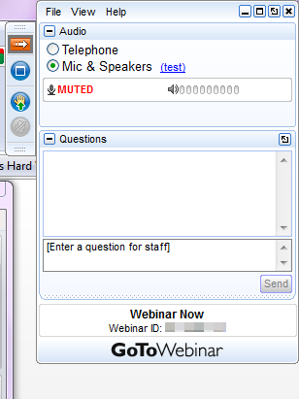
Webinar: Rules of the game
No voice interaction allowed during the presentations
You can write your questions in the chat specifying the speaker you want to address
We'll forward the questions in the Question & Answer session at the end
This webinar will be recorded and published in the EIP SCC website
Expand & Collapse your panel
Raise your hand
NOT USED
Mute/ Unmute
Write here your questions
Notes:
THINGS TO TELL TO ATTENDEES:
Mute/Unmute:
All attendees will be muted by default. Only the organiser can unmute you.
If you have been unmuted by the moderator and she forgot to mute you, you can always mute yourself again
To ask questions:
It is important to write the questions specifying who is the panelist who should answer.
Questions can be written all along the webinar, thus allowing the moderator to better organise the Q&A session
The moderator will read the questions when all presentations have finished, during the Q&A session
To rise hand:
We strongly prefer you to write the question instead of rising hand, thus allowing us to group and prioritise question according to content

Slide 3
INDEX
AC BM Background: The EIP Initiatives
AC Business Models: our aim
AC Business Models: Next steps

Slide 4
1. AC BM Background: The EIP Initiatives
Citizen Focus
Int. Planning, Policy & Regulation
Citizen City: tools for citizen engagement
Tools for decision making and benchmarking
Scaling up & replication of smart city plans
Citizen Centric approach to data
From Planning to Implementation
Governance for Cultural Heritage
Business Models, Finance and Procurement
Cross-Nations Exchange
Sustainable Districts
Small Giants
Integrated Infrastructures
Positive Energy Blocks
Humble Lamppost
Sustainable Urban Mobility
Urban Platform
Electromobility
Cross-city transformation
New mobility services

Slide 5
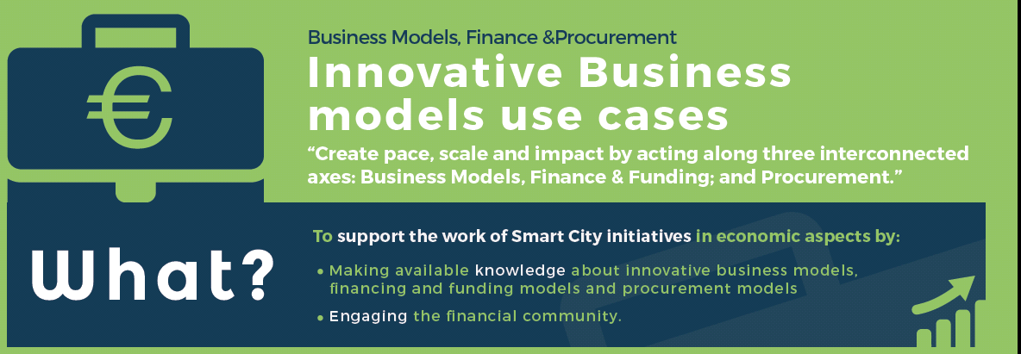
AC Business Models: our aim
Under the initiative “Innovative Business Models”, the AC aims to achieve following strategic objectives:

Slide 6
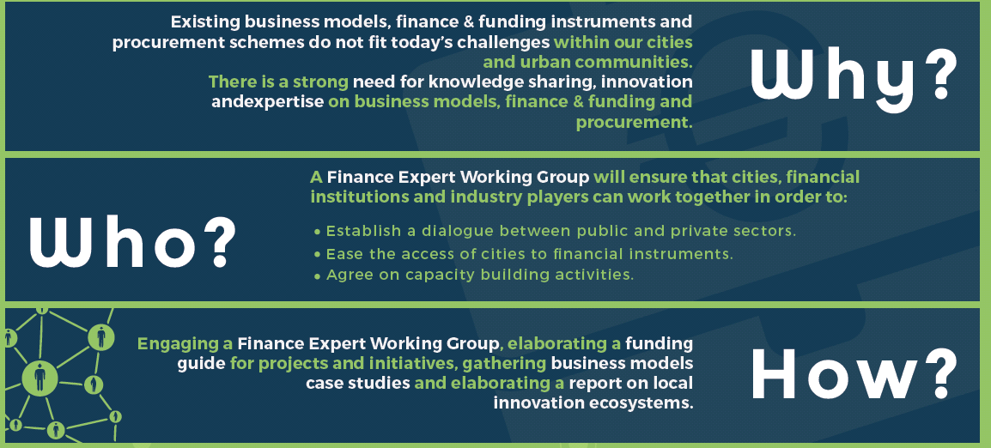
AC Business Models: our aim
As strategy for achieving these objectives, the AC has developed its Roadmap for 2016:

Slide 7
AC Business Models: Next steps

Slide 8
The Report on Local Innovation Ecosystems by Mikael Edelstam is available in our webpage. Feel free to send any comment/suggestion.
We are looking for case studies on succesfull business model in the area of energy, mobility, ICT, smart cities projects and commitments. By 4th September 2016 to Anja De Cunto: Anja.DeCunto@eurocities.eu.

Slide 9
If you are interested in hosting or contributing to a webinar relating to business models, finance and procurement, please contact Anja De Cunto with details of any potential topics.
The next meeting of the Action clusters on business models will take place in Brussels next 22 November. Minutes and presentations from our latest meeting in Eindhoven on 24 May.

Slide 10
Increasing capacities in Cities for innovating financing in energy efficiency
A review of local authority innovative large scale
retrofit financing and operational models
Miguel A. Casas
Energinvest – CITYnvest
February, 2016

Slide 11
Content
Introduction to the CITYnvest project
Scope and structure of the study of 24 selected large scale retrofit programs
Comparison of the models and major findings
Conclusions
Guidance material

Slide 12
Introduction to the CITYnvest project
Miguel A. Casas
Energinvest – CITYnvest
February, 2016

Slide 13
Introduction: The rationale for CITYnvest
How to accelerate investments?
No need for reinventing the wheel
Catalyst role for LRA – reflected in current EU directives, but some remaining challenges
Financiers
- predictability of risks
- standardization
- cash flows (IRR, NPV)
- transaction costs
Local EE projects
- capacity constraints (no core business)
- Bankability mentality
- ESA Accounting rules
- bundling needs

Slide 14
CITYnvest scope: Wide scale capacity building
In-depth study
24 models analysed
Guidance material
3 Pilot projects
Liège (BE)
Murcia (S)
10 focus countries
Guidance material
Capacity building
Rodhope (BG)

Slide 15
Scope and structure of the study of 24 selected large scale retrofit programs
Miguel A. Casas
Energinvest – CITYnvest
February, 2016

Slide 16
In-depth study: What have we done?
Analysed 24 existing models addressing large scale and deep energy efficiency retrofit programs (including RES) involving public authorities across Europe (11 countries)
Ambition, implementation technology, services to beneficiaries, financing schemes
Provided benchmark/comparison along such themes as:
Operational schemes: Facilitation/Integration /Financing only
Implementation model: Separate Contractor Based (SCB) and EPC/ESC
Financial schemes and related attractiveness and risks
Provided guidance material to support local authorities in their search for financing of their EE and RES programs

Slide 17
Business models: Common practices
Program Authority
Public entity or organization in charge of the program or that controls the program.
Define the program including the targeted beneficiaries, the level of ambition, the implementation/operational models and the funding vehicle that is being put in place (political commitment).
Program Delivery Unit
Public and/or private entity set-up to implement/execute the program.
Beneficiaries
Receive services from the PDU according to the chosen operational and implementation models. Services can include financing of the projects.
Often a Contractual framework is concluded between the PA and/or the PDU and the beneficiaries in order to access the PDU portfolio of services.
Set-up and fund the Program Delivery Unit (PDU).
Often a separate legal entity, but can also be a department or project team within an existing organization.

Slide 18
Business models: Main features
2
Implementation Models
Separate contracting based (SCB)
Energy Performance Contracting (EPC)/Energy Supply Contracting (ESC)
3 Operational Models
Facilitation
Integration
7 Operating Services
Marketing
Assessment
5 Funding Vehicles
Financial Institutions
ESCO’s
Program Delivery Unit (PDU)
Investment Funds
Citizens
Financing only
Financial advice
Facilitation
Integration
Aggregation
Financing

Slide 19
PDU Operational models: Main differences?
FACILIATION (16/24)
INTEGRATION (8/24)
FINANCING ONLY (3/24)
Beneficiaries are the tendering and contracting authorities.
PDU is the tendering and contracting authority.
Beneficiaries are the tendering and contracting authorities.
Contracts are signed between beneficiaries and ESCO/Contractors (deliver the retrofit works to the beneficiaries).
Contracts are signed between PDU and the ESCO/Contractors. PDU delivers the retrofit works to the beneficiaries.
Contracts are signed between beneficiaries the ESCO/Contractors (deliver the retrofit works to the beneficiaries).
PDU facilitates the projects by assisting the beneficiaries during the preparation, the tendering process and the follow-up of the projects.
PDU takes on the preparation, the tendering process and the follow-up of the projects. PDU delivers the retrofit works to the beneficiaries.
PDU assesses the bankability of the projects and provides financing.
PDU shares no risks.
PDU takes on the technical risks.
PDU takes on the financial risks.
The main difference between the two models is the contractual relationship with the ESCO or contractors and the resulting impact on the risks and public balance sheet of the PDU.

Slide 20
PDU Operating Services: From low to high integration
Low
Level of services
High
 | Standard services | Aggregation | Financing
Marketing | Covers the whole range of promotion, communication and commercial development services necessary to inform the beneficiaries of the types of offerings that are available to them. | The PDU bundles the projects of multiple beneficiaries by acting on behalf of them and by making them available to the market. This role can be associated to the integration or facilitation services. In both cases the PDU manages the cost allocation between the beneficiaries. Aggregation is done to create economies of scale both operationally and financially. | The PDU itself provides financing, either through an own fund or by packaging external financing solutions into an integrated financing service. In this case the PDU takes on the financial risk of the projects. This option is typically used where a dedicated fund is created as part of the energy efficiency program.
Assessment | PDU evaluates the technical and financial viability of the projects and decides whether or not they get implemented and/or financed.
Financial advice | PDU provides guidance and consultancy to the beneficiary on available funding for his project.
Facilitation | PDU does not sign the contracts with the beneficiaries, but coordinates or “facilitates” the whole process of projects delivery on behalf of the beneficiaries.
Integration | PDU acts as an intermediary between the beneficiaries on one hand and the ESCO/contractors on the other hand. In this case, the PDU is the tender and contracting authority.
Low
Level of services
High

Slide 21
Comparison of the models and major findings
Miguel A. Casas
Energinvest – CITYnvest
February, 2016

Slide 22
Models positioning: Models involving facilitation are mainly financed via Financial Institutions or ESCOs while models using integration are mainly financed through the Program Delivery Unit (PDU) or an investment fund.
 | Facilitator |  | Integrator |  | Financing only
 | No aggregation | Aggregation | No aggregation | Aggregation
Esco financing | REDIBA Eco’Energies EERFS | Berlin ESP RE:FIT VEB Rotterdam GB EE Milan PadovaFIT! | - | - | N/A
Financial institutions | REDIBA Eco’Energies EERFS | Berlin ESP RE:FIT VEB ENSAMB Energie POSIT’IF | Warm Up North | - | N/A
Program Delivery Unit financing | OSER | Fedesco Ox Futures | OSER | Fedesco Energie POSIT’IF Eandis EDLB EscoLimburg 2020 SPEE Picardie | N/A
Investment Fund | EERFS SUNShINE | - | - | EscoLImburg 2020 Cambridgeshire MLEI | Energy Fund Den Haag KredEx
Citizens financing | - | Ox Futures Brixton Energy Co-op | - | - | Climate Community Saerbeck

Slide 23
Level of Ambition: The great majority of the models target Perimeter 1 or “standard market practice”, though factor 2 (50% savings) models gain in attention, factor 4 (75% savings) remain marginal.
Over 1.200€/m2
Up to 1.200€/m2
Up to 200€/m2
Up to 50€/m2

Slide 24
Conclusions
Miguel A. Casas
Energinvest – CITYnvest
February, 2016

Slide 25
Some conclusions/remarks
Success of models often correlated with the existence of
well-functioning Program Delivery Unit, and
clear leadership role of the public partner (ambition and willingness to invest)
Lower ambition levels (<35% savings) mostly driven by:
facilitation models
EPC/ESC implementation
ESCO and/or Financial Institutions financing
Factor 2 (50% savings) and factor 4 (75% savings) ambition levels are very often “integration” driven, both technically as financially.
High energy efficiency ambition levels (factor 2 and factor 4) do not focus on short to medium term pay-back terms (need other financing vehicle than ESCO or FI). In other words, profitability is only one of the many investment citeria
Absolute need for project developers to prepare high quality business cases to enable proper investment decisions and enhanced bankability

Slide 26
Guidance material
Miguel A. Casas
Energinvest – CITYnvest
February, 2016

Slide 27
Next: Strategic planning and action plan template
Follow the step-to-step guidance tools
Decision mapping
Strategic analysis
Program Authority/Program Delivery Unit roles and functions
Beneficiaries, type of projects and level of “ambition”
Implementation model
Operating Services
Level of “aggregation”
Financing & Funding Vehicle
Choice – What are you proposing to do?
Action plan for implementation

Slide 28
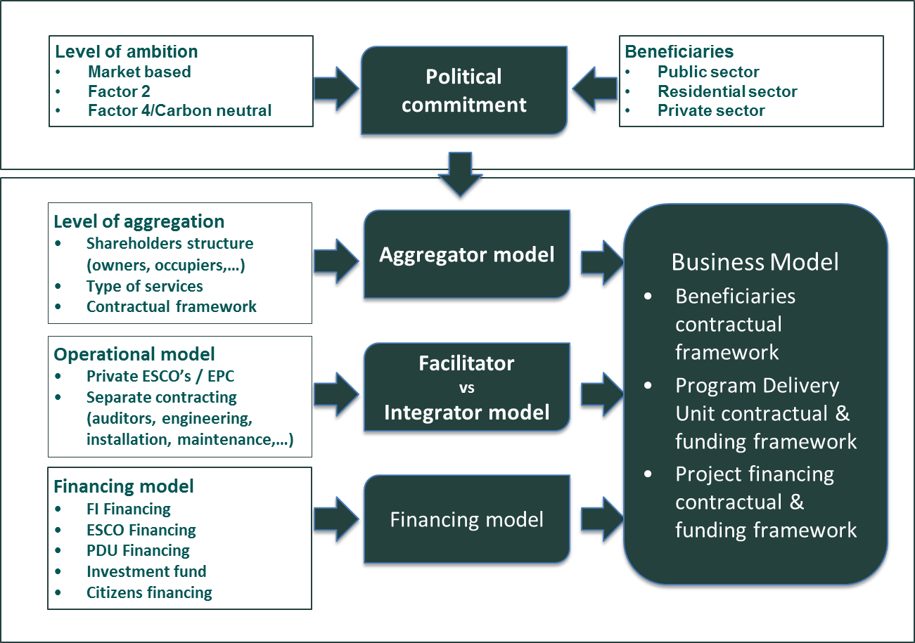
Decision mapping
Read the CITYnvest Comparison report
Make use of the tools at your disposal on our website:
Recommendation-decision matrix.
Strategic action plan template
Evaluation toolkit.

Slide 29
Miguel A. Casas
Energinvest
mcasas@energinvest.be
+32 495 581 330
Jean-François Marchand
Energinvest
jfmarchand@energinvest.be
Lieven Vanstraelen
Energinvest
lvanstraelen@energinvest.be
+32 495 551 559
Copyright in the CITYnvest report is reserved by Energinvest SPRL. However, readers are given a royalty free licence to use the report.

