Slide 1
CITYnvest
Energy Efficiency Finance Market Place
Parallel session ‘Innovative financing schemes, capacity building and awareness raising’
18 January 2017
Brussels
Jean-Francois Marchand (Energinvest), Ivanka Pandelieva (SEC), Rafal Ataz Gomez (InfoMurcia) and Elise Steyaert (Climate Alliance)
18/01/2017

Slide 2
Structure of this session
The Rationale of CITYnvest
Where CITYnvest stands today
  Guidance and capacity-building
  Experimenting and implementing in the three pilot regions:
    Liège – Renowatt
    Rhodope – Rhodoshop
    Murcia
  Wide-scale capacity-building programme on the national level
  Monitoring of investments and energy savings
Key lessons learned and overcoming challenges

Slide 3
Rationale of CITYnvest
EE financing models and EPC market remains far away reality for local authorities because of perception gap:
Financiers
- predictability of risks
- standardization
- cash flows (IRR, NPV)
- transaction costs
Local EPC projects
- capacity constraints (no core business)
- Bankability mentality
- ESA Accounting rules
- bundling needs

Slide 4
Holistic solutions framework: what CITYnvest has to offer
In-depth study
26 models analysed
Guidance material
3 Pilot projects
Liège (BE)
Murcia (S)
10 focus countries
Guidance material
Capacity building
Rodhope (BG)

Slide 5
In-depth study: What have we done?
Analysed 26 existing models addressing large scale and deep energy efficiency retrofit programs (including RES) involving public authorities across Europe (11 countries)
    Ambition, implementation technology, services to beneficiaries, financing schemes
Provided benchmark/comparison along such themes as:
    Operational schemes: Facilitation/Integration /Aggregation
    Implementation model: Separate Contractor Based (SCB) and EPC/ESC
    Financial schemes and related attractiveness and risks
Provided guidance material to support local authorities in their search for financing of their EE and RES programs

Slide 6
Business models: Common practices
Program Authority
Public entity or organization in charge of the program or that controls the program.
Define the program including the targeted beneficiaries, the level of ambition, the implementation/operational models and the funding vehicle that is being put in place (political commitment).
Program Delivery Unit
Public and/or private entity set-up to implement/execute the program.
Beneficiaries
The PDU delivers services to the beneficiaries according to the chosen operational and implementation models. Services can include financing of the projects.
Most of the times, a Contractual framework is concluded between the PA and/or the PDU and the beneficiaries to access the PDU portfolio of services.
Set-up and fund the Program Delivery Unit (PDU).
Often a separate legal entity, but can also be a department or project team within an existing organization.

Slide 7
Business models: What are the main characteristics?
2 Implementation Models
Separate contracting based (SCB)
Energy Performance Contracting/Energy Supply Contracting (EPC/ESC)
3
Operational Models
Facilitation
Integration
7
Operating Services
Marketing
Assessment
5
Funding Vehicles
Financial Institutions
ESCO’s
Program Delivery Unit (PDU)
Investment Funds
Citizens
Financing only
Financial advice
Facilitation
Integration
Aggregation
Financing

Slide 8
PDU Operational models: What are the differences?
FACILIATION (16/24)
INTEGRATION (8/24)
FINANCING ONLY (3/24)
Beneficiaries are the tendering and contracting authorities.
PDU is the tendering and contracting authority.
Beneficiaries are the tendering and contracting authorities.
Contracts are signed between beneficiaries and ESCO/Contractors (deliver the retrofit works to the beneficiaries).
Contracts are signed between PDU and the ESCO/Contractors. PDU delivers the retrofit works to the beneficiaries.
Contracts are signed between beneficiaries the ESCO/Contractors (deliver the retrofit works to the beneficiaries).
PDU facilitates the projects by assisting the beneficiaries during the preparation, the tendering process and the follow-up of the projects.
PDU takes on the preparation, the tendering process and the follow-up of the projects. PDU delivers the retrofit works to the beneficiaries.
PDU assesses the bankability of the projects and provides financing.
PDU shares no risks.
PDU takes on the technical risks.
PDU takes on the financial risks.
The main difference between the models is the contractual relationship with the ESCO or contractors and the resulting impact on the risks and public balance sheet of the PDU.

Slide 9
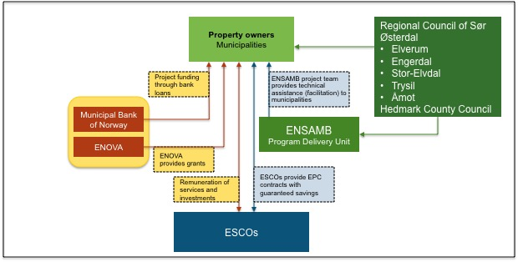
Municipal example: ENSAMB

Slide 10
Models positioning: Models involving facilitation are mainly financed via Financial Institutions or ESCOs while models using integration are mainly financed through the Program Delivery Unit (PDU) or an investment fund.
 | Facilitator |  | Integrator |  | Financing only
 | No aggregation | Aggregation | No aggregation | Aggregation
Esco financing | REDIBA Eco’Energies EERFS | Berlin ESP RE:FIT VEB Rotterdam GB EE Milan PadovaFIT! | - | - | N/A
Financial institutions | REDIBA Eco’Energies EERFS | Berlin ESP RE:FIT VEB ENSAMB Energie POSIT’IF | Warm Up North | - | N/A
Program Delivery Unit financing | OSER | Fedesco Ox Futures | OSER | Fedesco Energie POSIT’IF Eandis EDLB EscoLimburg 2020 SPEE Picardie | N/A
Investment Fund | EERFS SUNShINE | - | - | EscoLImburg 2020 Cambridgeshire MLEI | Energy Fund Den Haag KredEx
Citizens financing | - | Ox Futures Brixton Energy Co-op | - | - | Climate Community Saerbeck

Slide 11
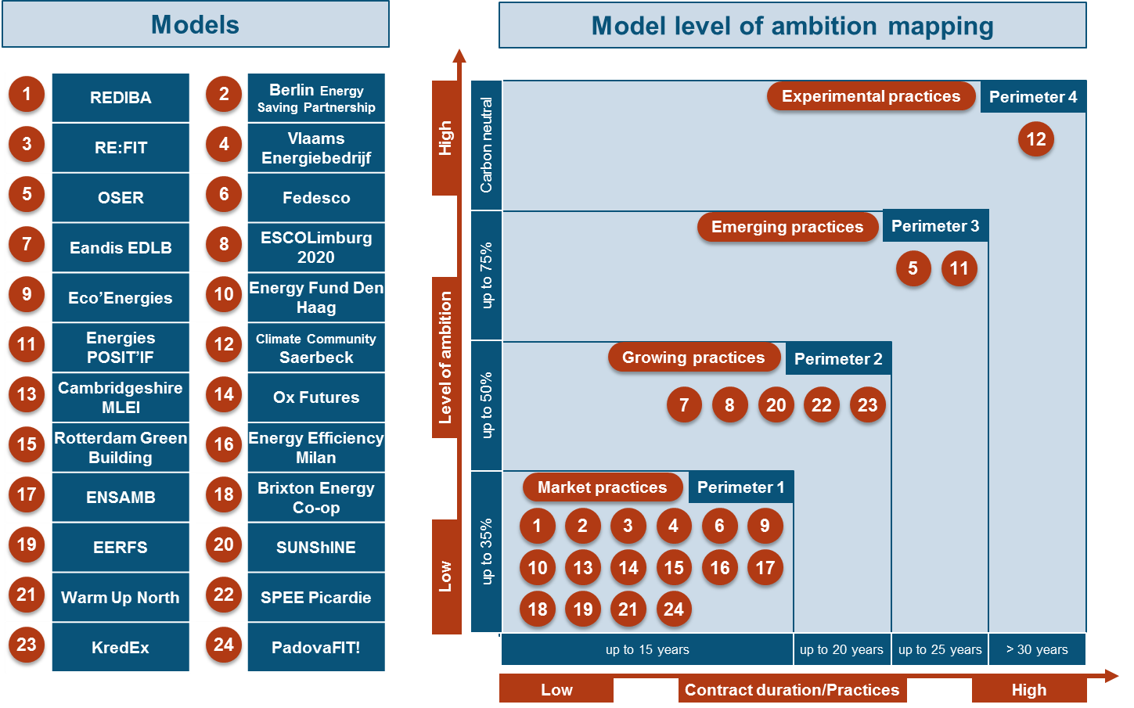
Level of Ambition: The great majority of the models target Perimeter 1 or “standard market practice”, though factor 2 (50% savings) models gain in attention, factor 4 (75% savings) remain marginal.
Over 1.200€/m2
Up to 1.200€/m2
Up to 200€/m2
Up to 50€/m2

Slide 12
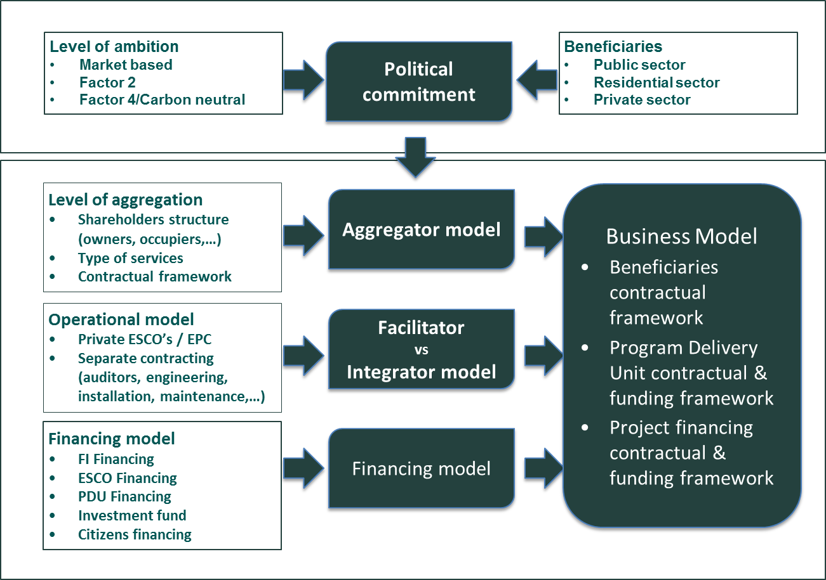
Decision mapping
Read the CITYnvest Comparison report
Make use of the tools at your disposal on our website:
Recommendation-decision matrix.
Strategic action plan template
Evaluation toolkit.

Slide 13
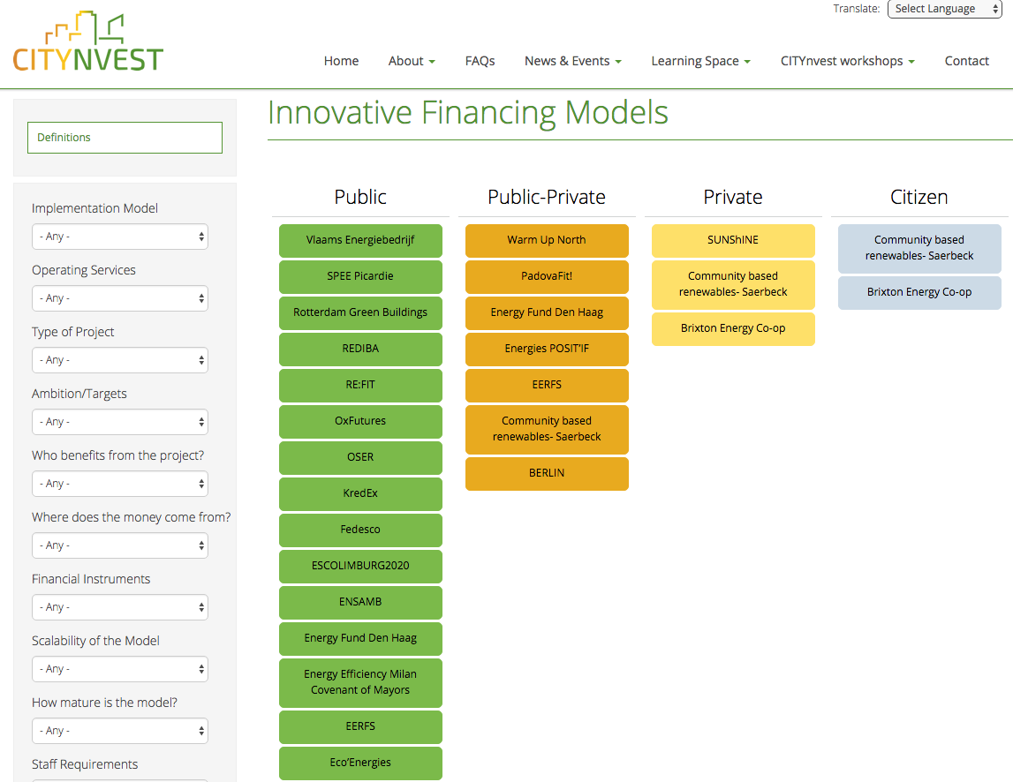
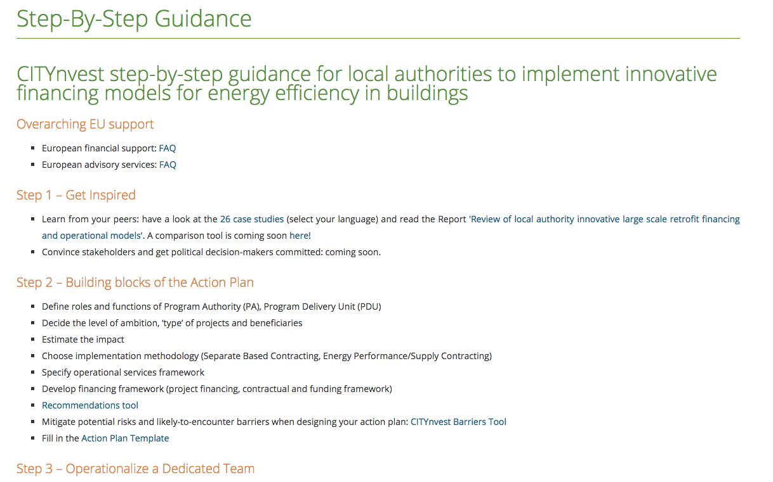
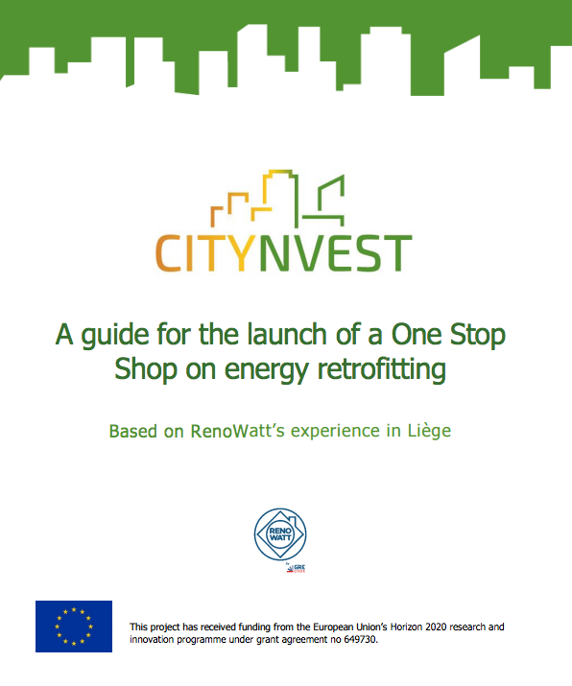
Capacity building Step-by-step guidance tools

Slide 14
Pilot Region Liège
Renowatt: One-Stop-Shop to launch EE urban Retrofitting
  Client support, project bundling and financing opportunities
  Clients: public authorities, hospitals/elderly care, private companies, households
Renowatt 1.0
CITYnvest added value
Renowatt 2.0
Dedicated technical team
Technical assistance support
Financing solutions
Central procurement service
New business model
Extended services target groups

Slide 15
Pilot Region Liège
Challenges and lessons learned so far:
  Convince public authorities
  Expensive procedure to prepare tender, importance TA and neutral facilitator
  Time dedication
  Expertise ESCO field
  Management of EPC contracts
  EPC is not silver bullet
  Political commitment = starting point (but check election timing!)
  Communication, communication and communication, at all level of the municipalities

Slide 16
Pilot region Rhodope – Main challenges
Organizational:
      Lack of administrative capacity to tackle sustainable energy projects;
      Lack of collaboration among municipalities.
Financial:
      ESCO market underdeveloped;
      Projects too small to gain critical mass for favorable financing terms.

Slide 17
One-Stop-Shop Rhodoshop Creation based on GRE-Liege Model
ACTION PLAN
Collect data and identify potential projects;
Calculate potential savings and investment needed;
Investigate local TPF/ESCO market;
Assess different operation models and present to local policy makers - General Assembly of ARM;
Define operational model for the programme and get approval by local policy makers;
Write the application for funding.
…
Central procurement agency
Project bundling in pipelines
Search for suitable financiers matching the specific project requirements and negotiate on secured conditions
Ensure launching tenders for public procurement of building and street lighting refurbishment works
Monitor project results

Slide 18
Critical Factors for Success
Knowledge of local situation: having dedicated staff and local support crucial (ARM and Smolyan Municipality);
Presence of local political commitment to sustainability and stimulating local jobs
Find the most active and influential municipality and get it on board (it will attract others): enhancing collaboration between municipalities
Undertake the work for One-Stop-Shop establishment (which is huge!)
Keep in constant touch, answer all questions, provide continuous support: Build local capacity for sustainable energy project development and implementation: technical and economic feasibility, financial planning

Slide 19
Pilot Region Murcia
Frame: Regional Energy Plan 2016-2020 that contains the Plan of Energy Efficiency in public buildings.
Target: energy efficiency plan for the renovation of the building stock owned by the regional government
Wide strategy: renovate the public buildings owned by the Murcia Region (409 buildings – 107 GWh – 26,6 millions € energy base line) with a preliminary estimated investment of 44,39 millions € that should lead to 23% energy savings (24,66 GWh, 64,119 GWhep, 6,12 millions € savings) and 16,005 avoided tons of CO2 per year.

Slide 20
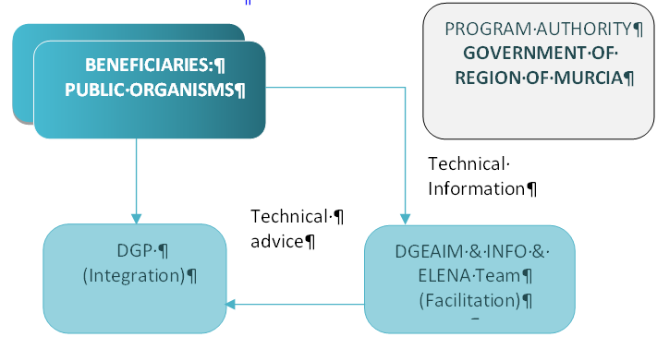
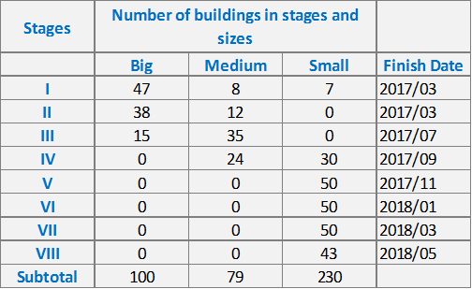
Murcia CITYnvest Action Plan
Key players
    Program Authority (PA): Murcia regional government
    Program Delivery Unit (PDU): Directorate General for Energy DGEAIM
    Supporting bodies: DGP & INFO
Type of buildings
    100 for large buildings, 79 projects for medium-size buildings and 230 projects for small buildings

Slide 21
    Energy Conservation Measures (ECMs):
      Façade renovation (mix between windows replacement and opaque facades placement)
      Inside lighting renovation (relighting with leds)
      Boiler retrofitting (biomass boilers)
      Air conditioning retrofitting (technical equipment replacement)
      Energy management (commissioning and regulation of the equipment)
Key issues:
      Hybrid Integration/Facilitation model
      Financing model based on ESCOs
Current stage of progress
      For the first group of 24 buildings contracts will be signed with an ESCO (Energy Services Company) that will acts as a unique contractor and assure all the technical risks of every contract. If the experience is positive this model will be extended to other groups of buildings, although other financing options have not been ruled out.

Slide 22
National Capacity Building programme
Long-term engagement strategy
Feedback forms and phone conversations
Follow-up web-page
National context and recommendations
CITYnvest guidance
Organisation of national workshop
Collaboration with local partners
Based on preparatory reports
Tailored support
10 focus countries
ES, BG, BE, LV, LT, FR, AT, IT, HU, RO

Slide 23
Monitoring of investments and energy savings
Complete overview of the proceedings of CITYnvest via defined objectives and KPIs (3 phases of development: quantitative and qualitative part)
Translate the local examples to a categorization and typology in order to increase the knowledge on the innovative financing schemes and the appropriate business models (complementing Recommendations Matrix)
Closing the loop of the guidance and capacity-building materials

Slide 24
Project coordination key lessons learned (1)
Management
    No need of fancy software: good communication will do
    Don’t build WPs as isolated islands: strength is in synergies
    Make sure those who carry out the work = beneficiaries
    Progress reports are an absolute asset for activity reports
    Participants portal will get rid of children diseases. Efficient helpdesk will hopefully remain
    Network with coordinator peers
Development of guidance materials
    Think earlier on its dissemination
    Build-in sufficient time for feedback loops
Barriers in pilot regions
    Financing and accounting rules
    Dependency on local commitment (plan well in advance of elections)
    Dependency on TA/PDA
    Standardization and aggregation needs
    Sensitivity of ownership

Slide 25
Project coordination key lessons learned (2)
Capacity-building in10 focus countries
    Strong partnerships are a must if you want a lasting impact
    The workshops = only starting point. Follow-up activities needed
Monitoring timeline
    Three pilot regions do not have same cycles and characteristics
Communication and dissemination
    Should be at the core – think from the start
    Starts with C & D between partners

Slide 26
Key lessons learned on the replication process
Time to market remains very long: operationalizing PDU 3 to 5 years. CITYnvest helps to speed up the process for the pilot regions.
TA is key to stimulate the development of PDU structures. The need for long term equity should be investigated.
Building a program and a PDU requires a strong commitment from PA. Stimulating local public authorities at the EU level should be investigated.

Slide 27
Next steps
Visit CITYnvest.eu to stay up-to-date!
Work towards acceleration of EE investments
Showing evidence: implementation 3 action plans in the pilot regions
Monitoring of successes and failures of investments
Building further synergies with initiatives (CoM) and SEIForums
Channelling recommendations to EU

Slide 28
Questions?

Slide 29
Jean-Francois Marchand, Ivanka Pandelieva, Rafael Ataz Gomez and Elise Steyaert
Energinvest, SEC, InfoMurcia and Climate Alliance
info@citynvest.eu
The content of this report reflects solely the Author’s view and the European Commission, EASME Agency, is not responsible for any use that may be made of the information it contains.

